Slide 1
Statistical models & design of experiments
Lecturer: Prof. Huynh T. Luong

Slide 2
Session 1 Basic concepts

Slide 3
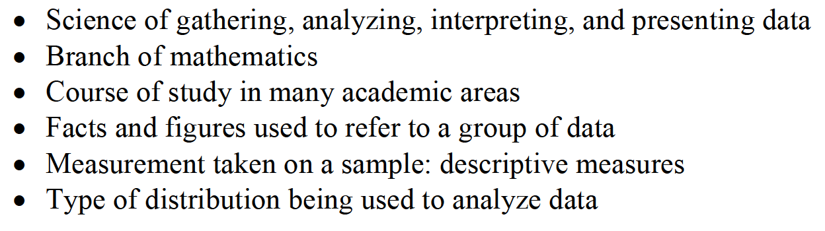
WHAT IS STATISTICS?

Slide 4
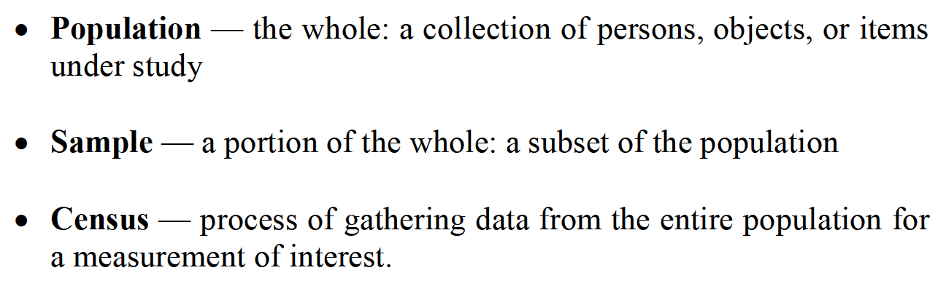
POPULATION VS. SAMPLE

Slide 5
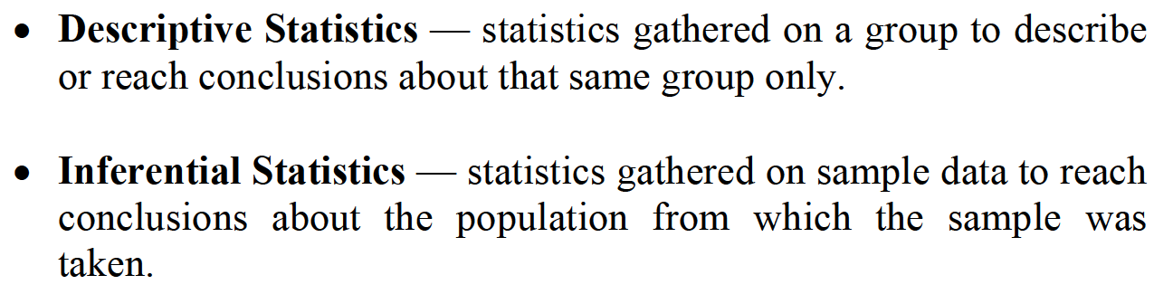
DESCRIPTIVE VS. INFERENTIAL STATISTICS

Slide 6
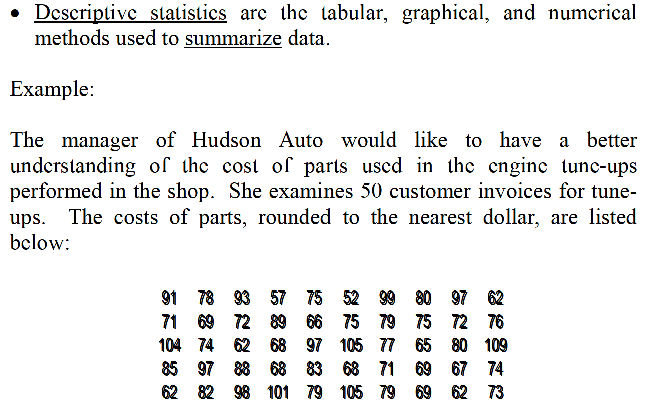
DESCRIPTIVE STATISTICS

Slide 7
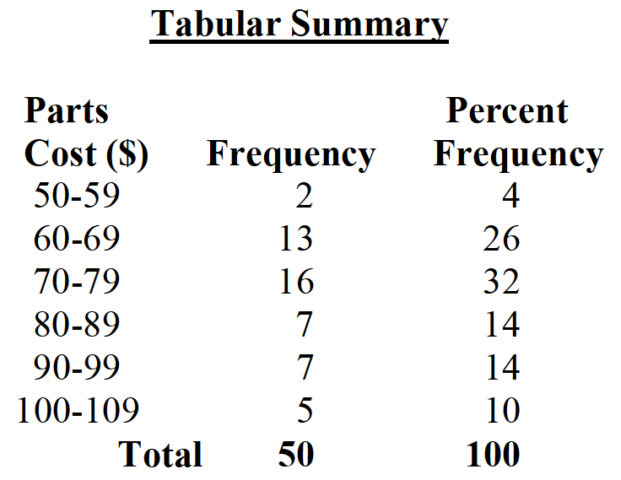
DESCRIPTIVE STATISTICS

Slide 8
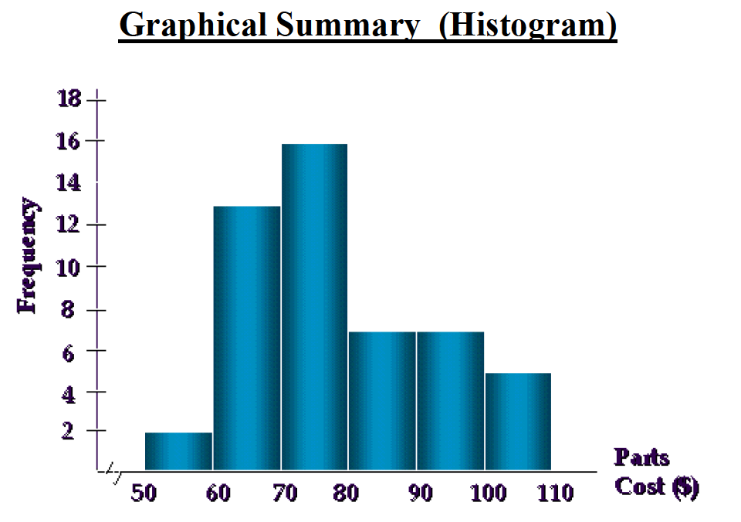
DESCRIPTIVE STATISTICS

Slide 9
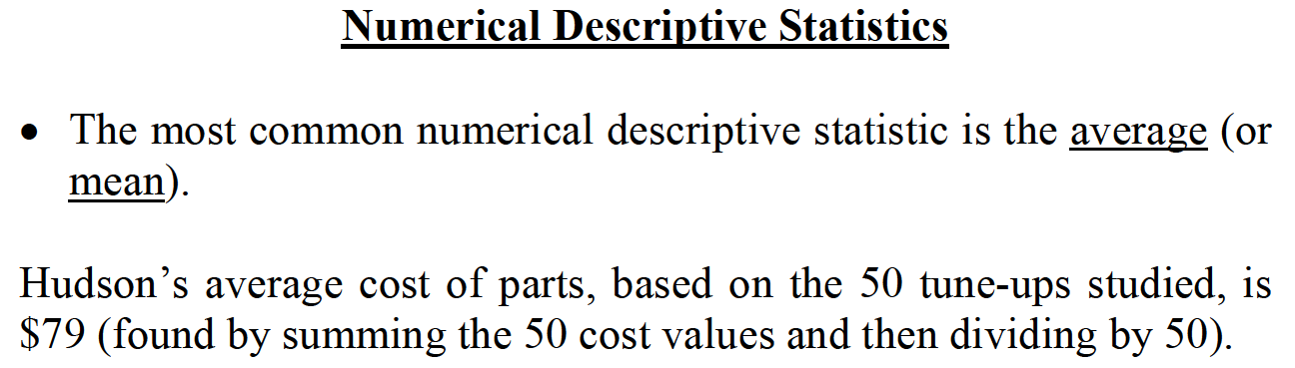
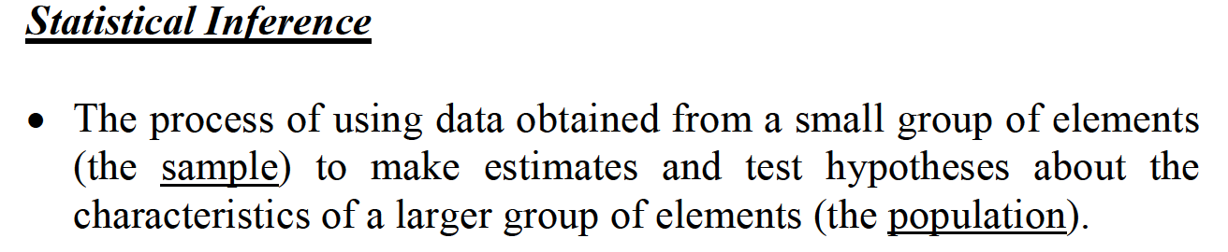
DESCRIPTIVE STATISTICS

Slide 10
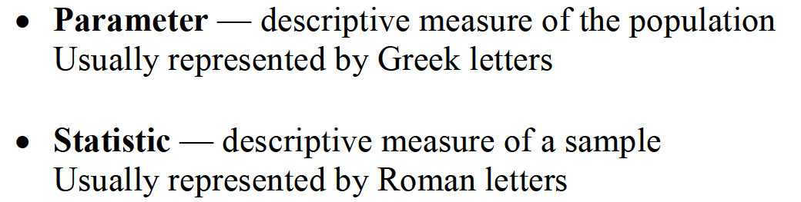
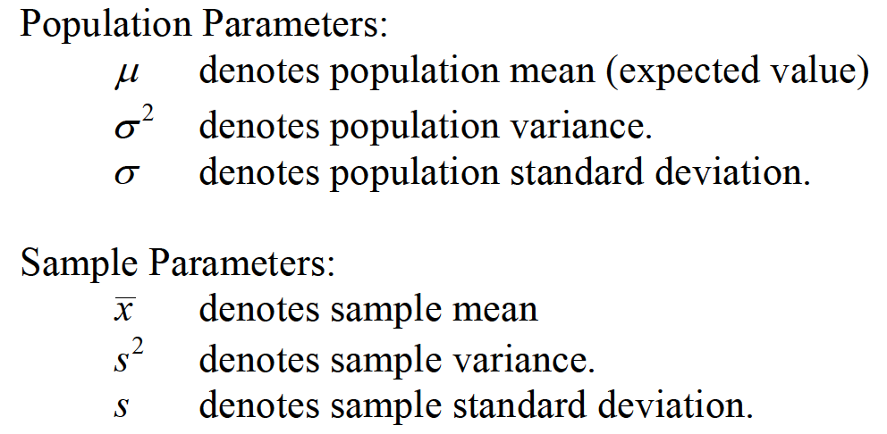
PARAMETER VS. STATISTIC

Slide 11
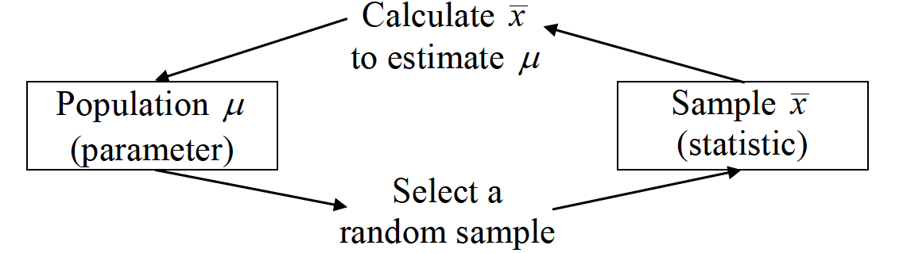
PROCESS OF INFERENTIAL STATISTIC

Slide 12
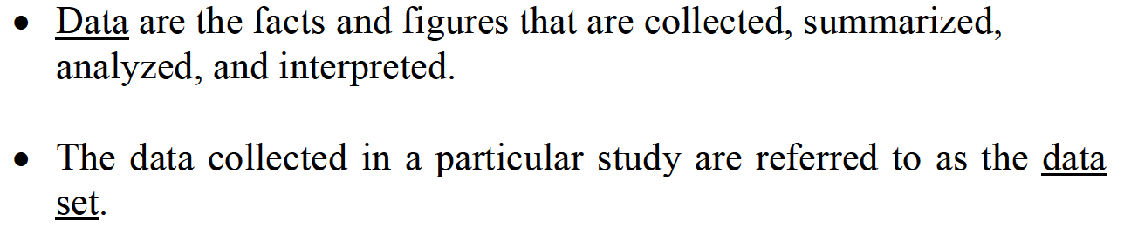
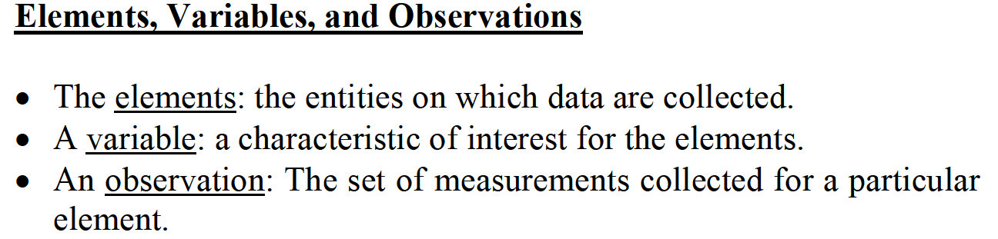
DATA

Slide 13
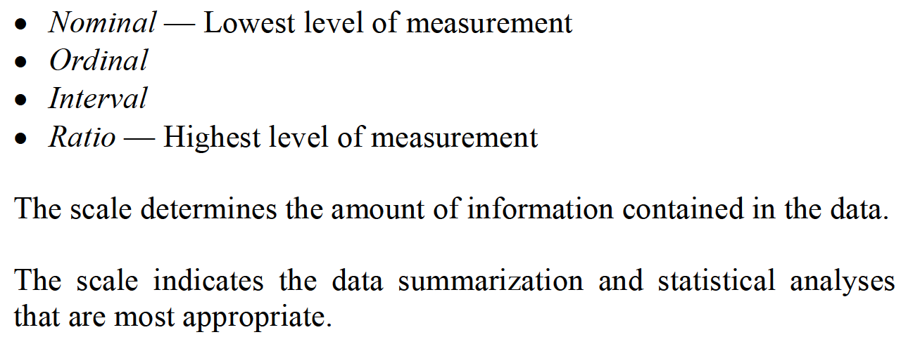
SCALES/LEVELS OF DATA MEASUREMENT

Slide 14
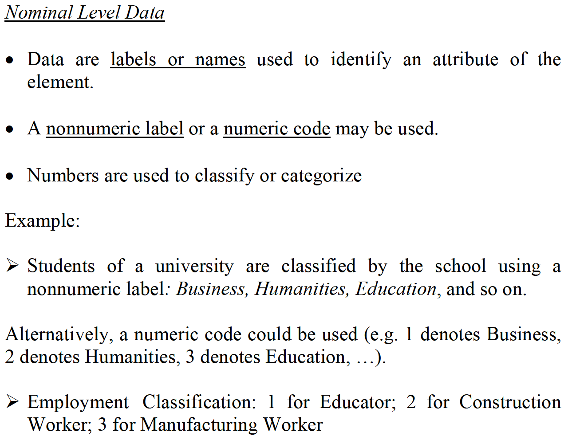
SCALES/LEVELS OF DATA MEASUREMENT

Slide 15
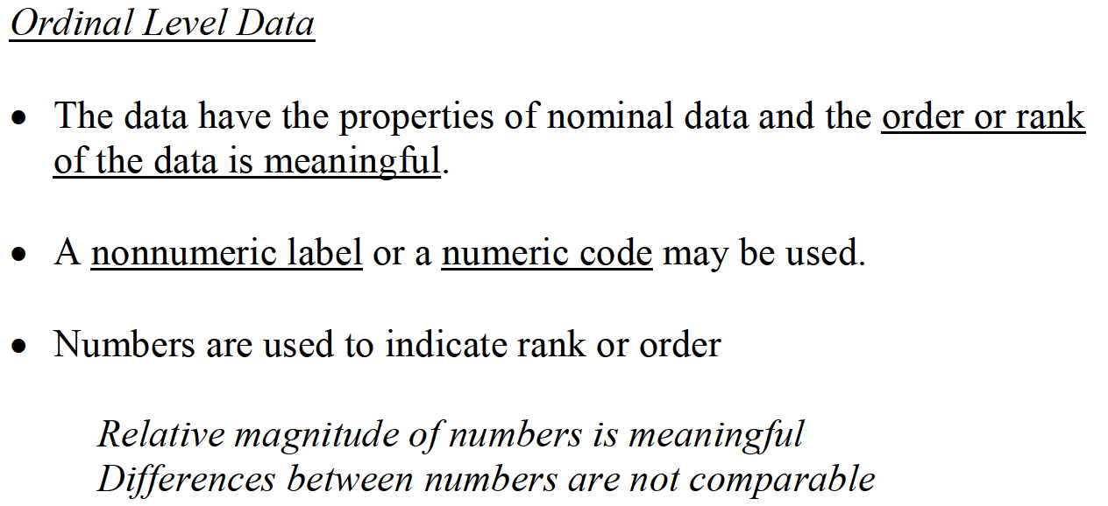
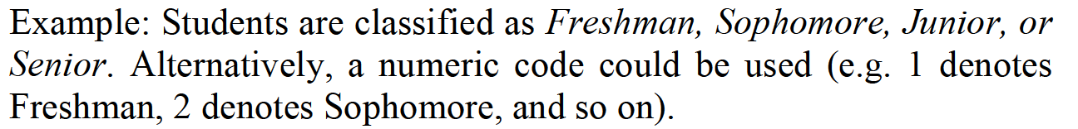
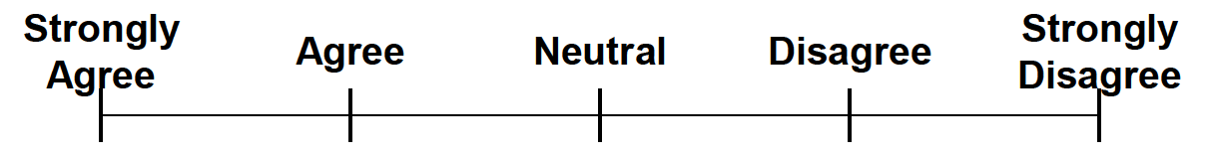
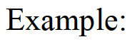
SCALES/LEVELS OF DATA MEASUREMENT

Slide 16
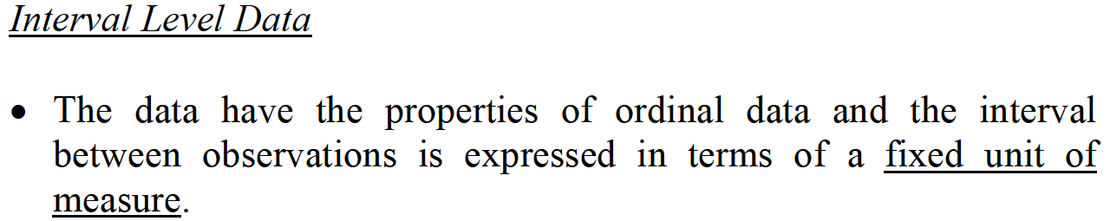
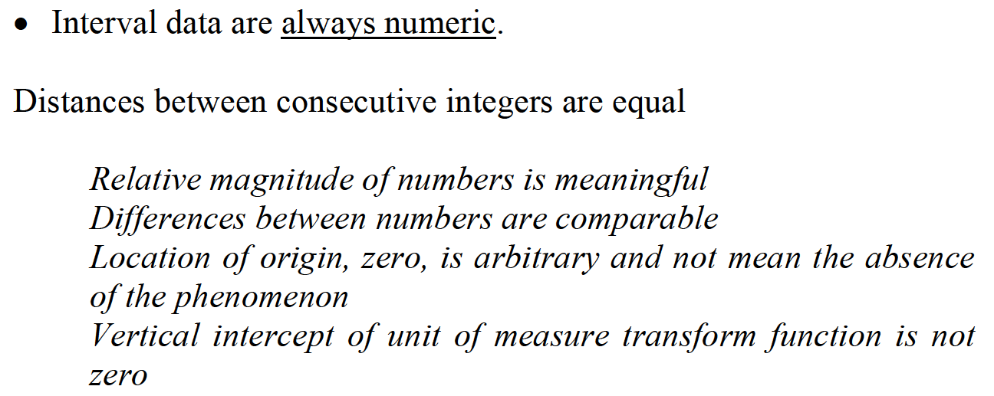
SCALES/LEVELS OF DATA MEASUREMENT

Slide 17
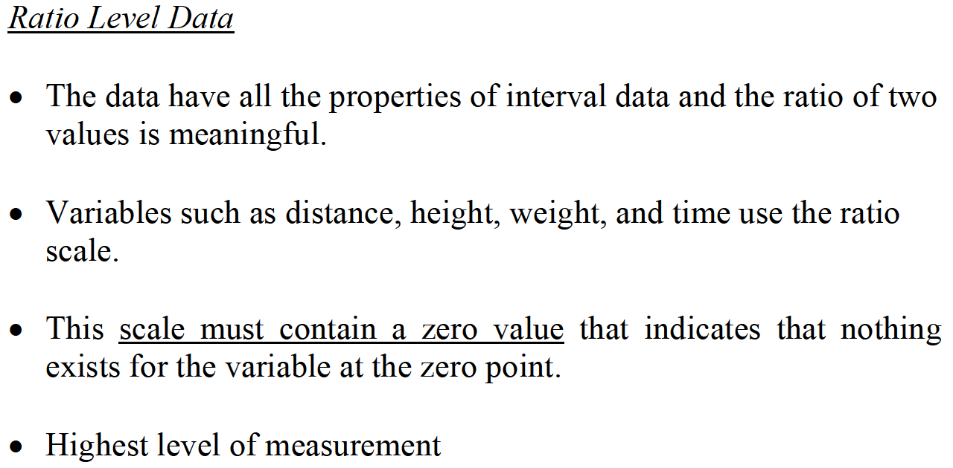
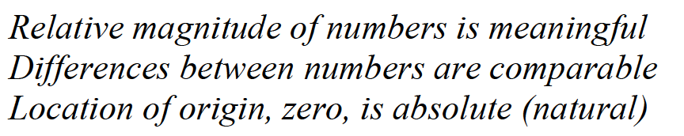
SCALES/LEVELS OF DATA MEASUREMENT

Slide 18
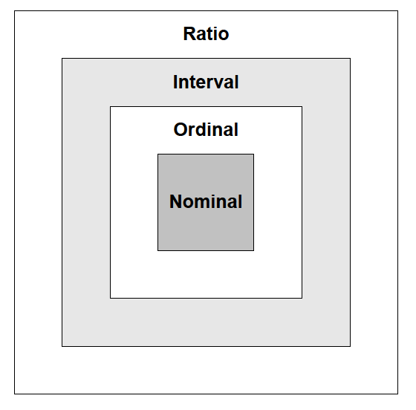
SCALES/LEVELS OF DATA MEASUREMENT

Slide 19
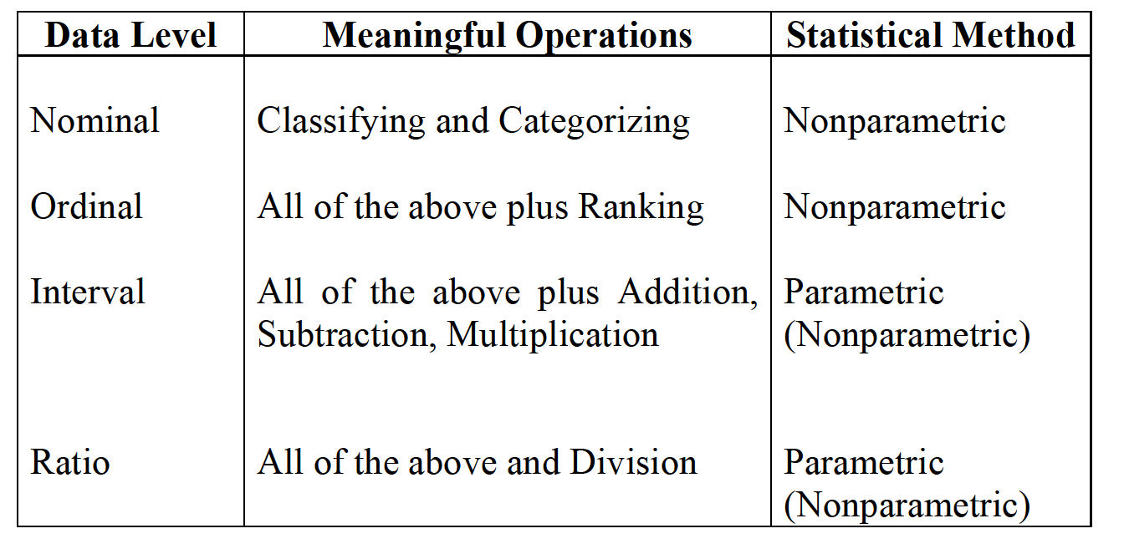
SCALES/LEVELS OF DATA MEASUREMENT

Slide 20
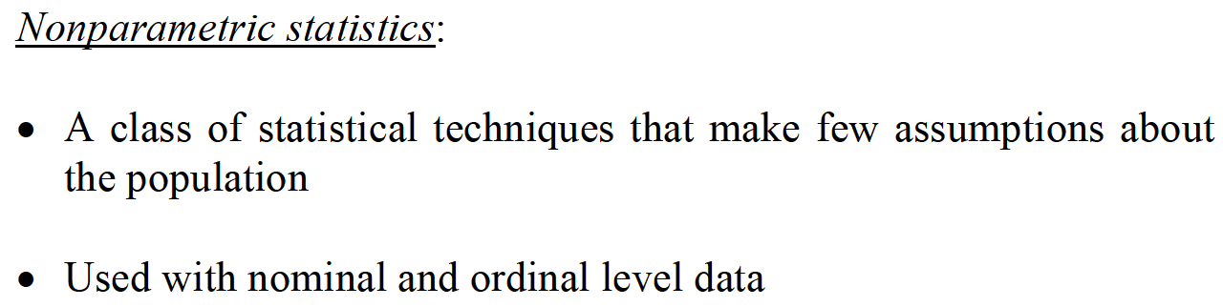
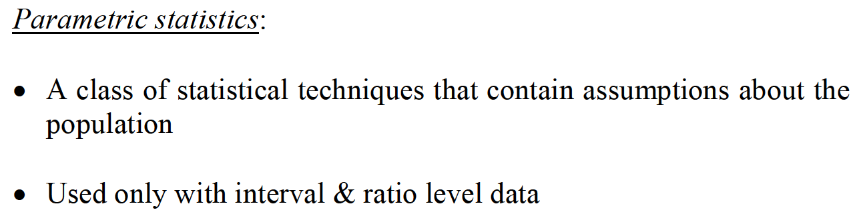
STATISTICAL METHODS

Slide 21
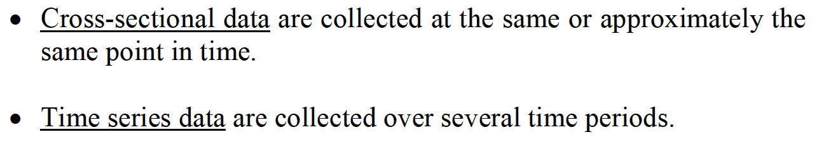
CROSS-SECTIONAL & TIME SERIES DATA

Slide 22
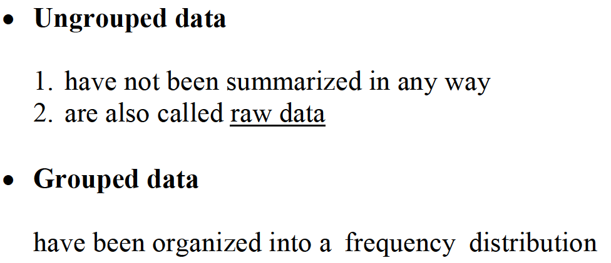
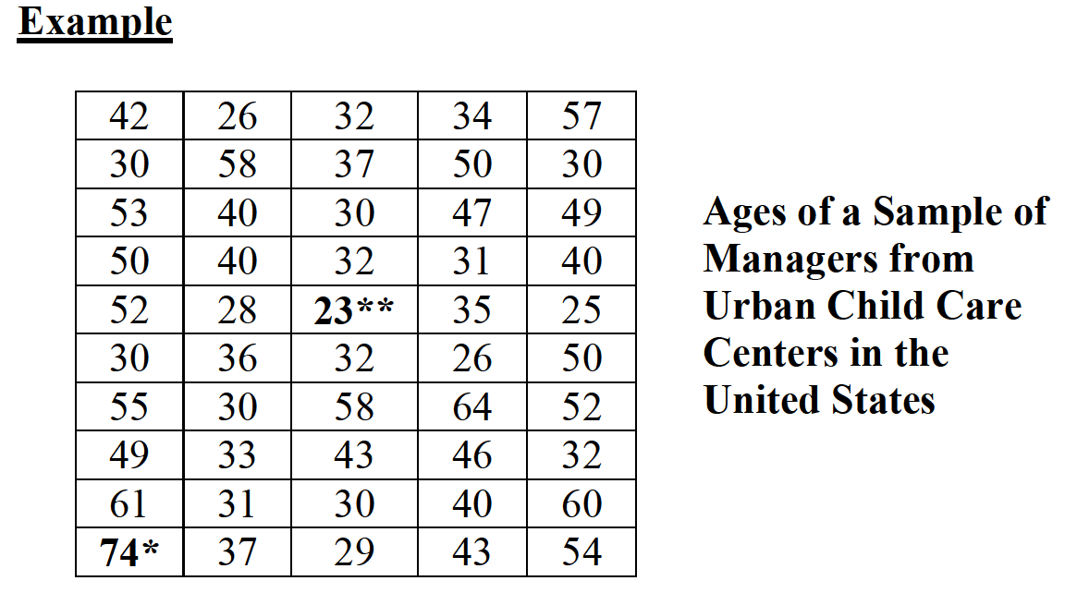
UNGROUPED VS. GROUPED DATA

Slide 23
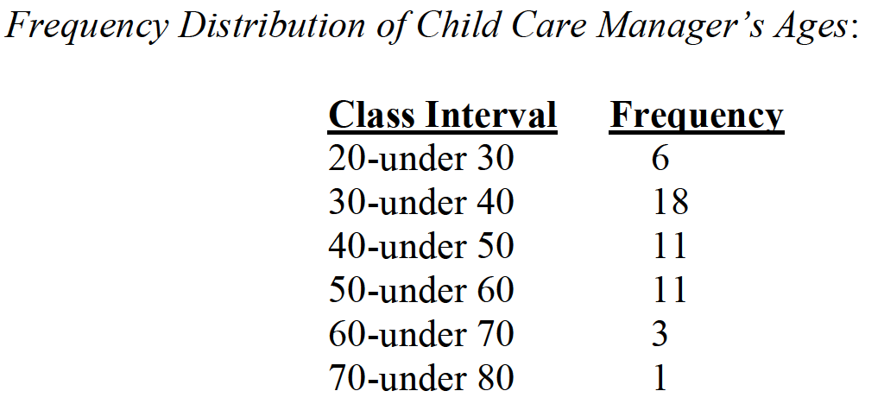
UNGROUPED VS. GROUPED DATA

Slide 24
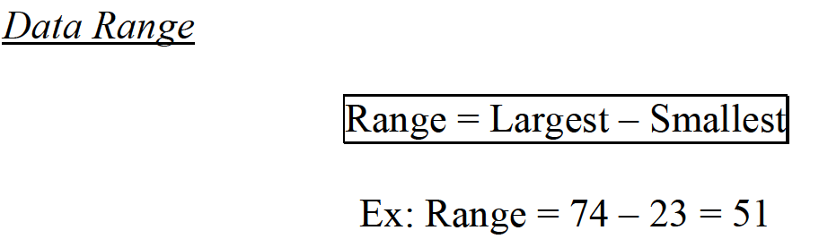
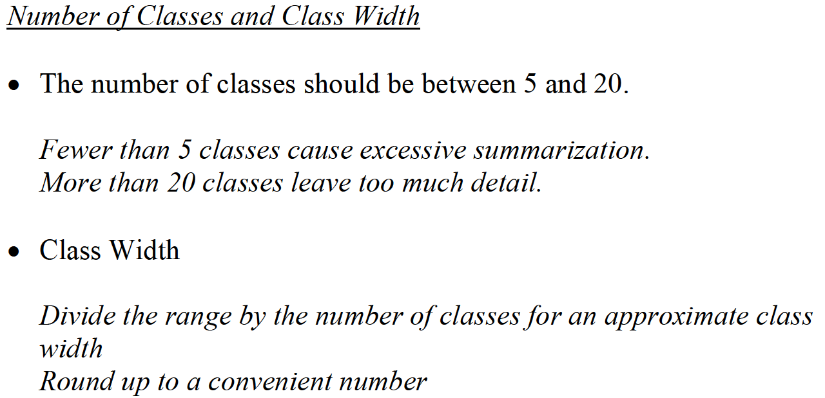
RANGE & CLASS

Slide 25
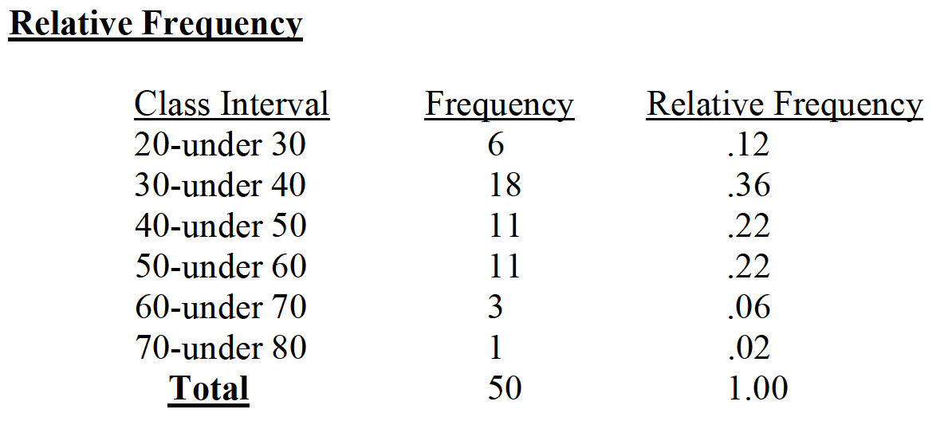
FREQUENCY ANALYSIS

Slide 26
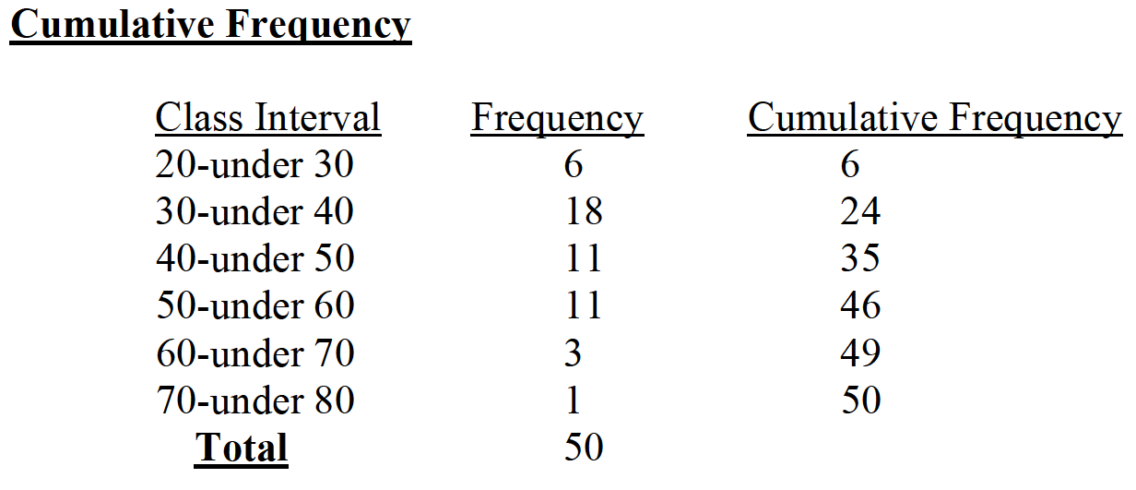
FREQUENCY ANALYSIS

Slide 27
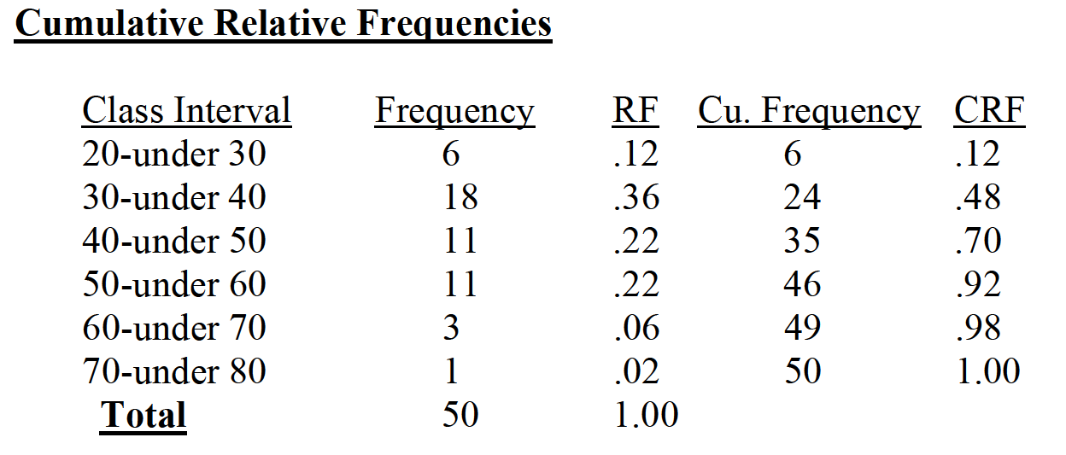
FREQUENCY ANALYSIS

Slide 28
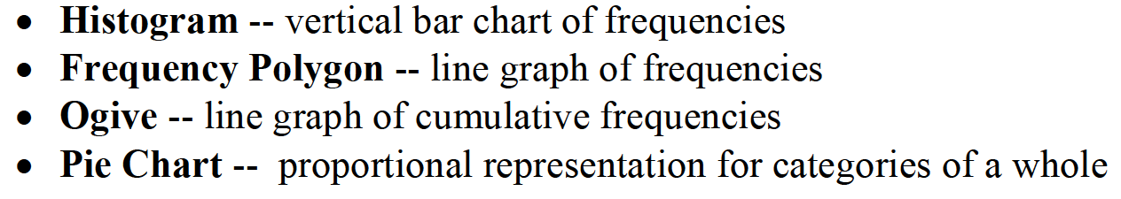
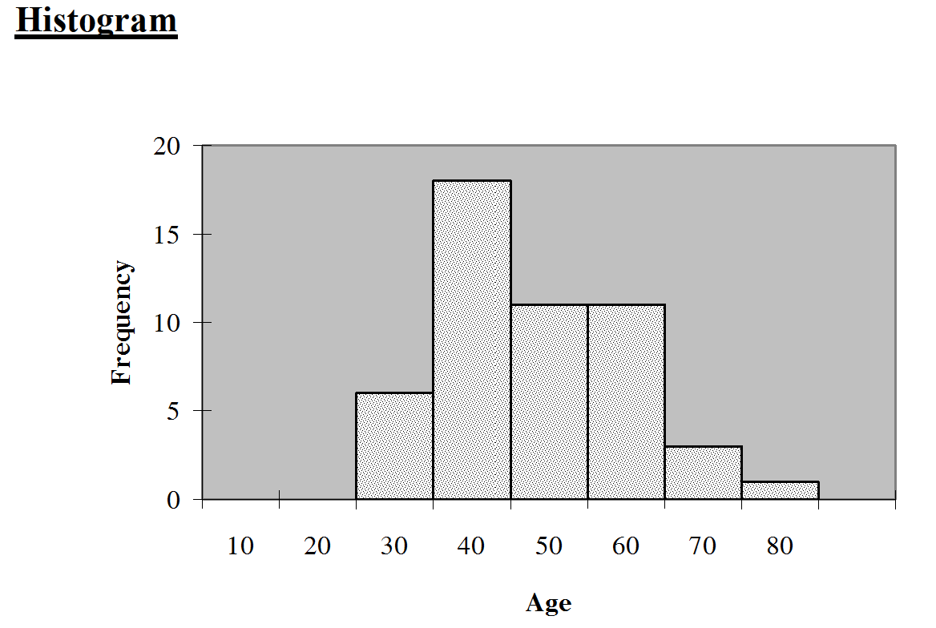
COMMON STATISTICAL GRAPHS

Slide 29
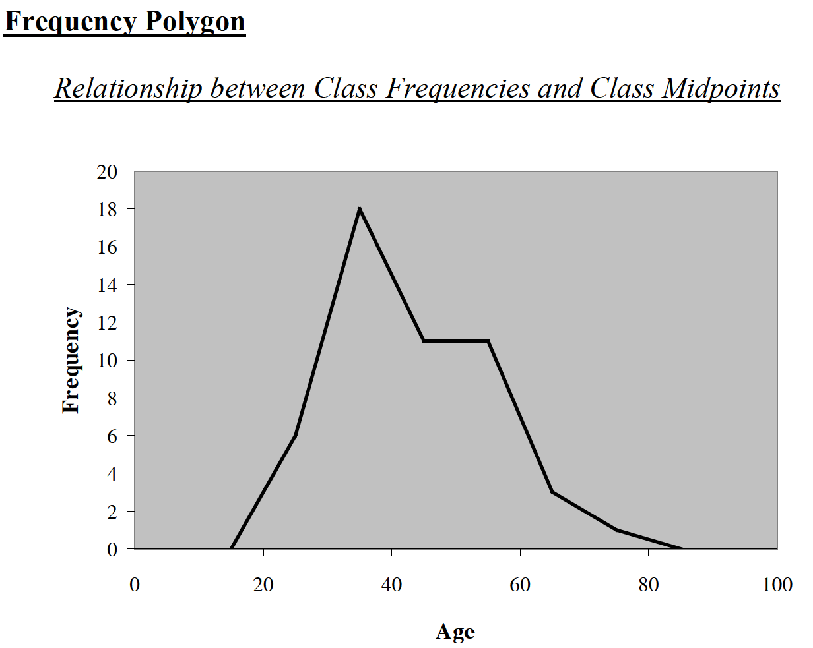
COMMON STATISTICAL GRAPHS

Slide 30
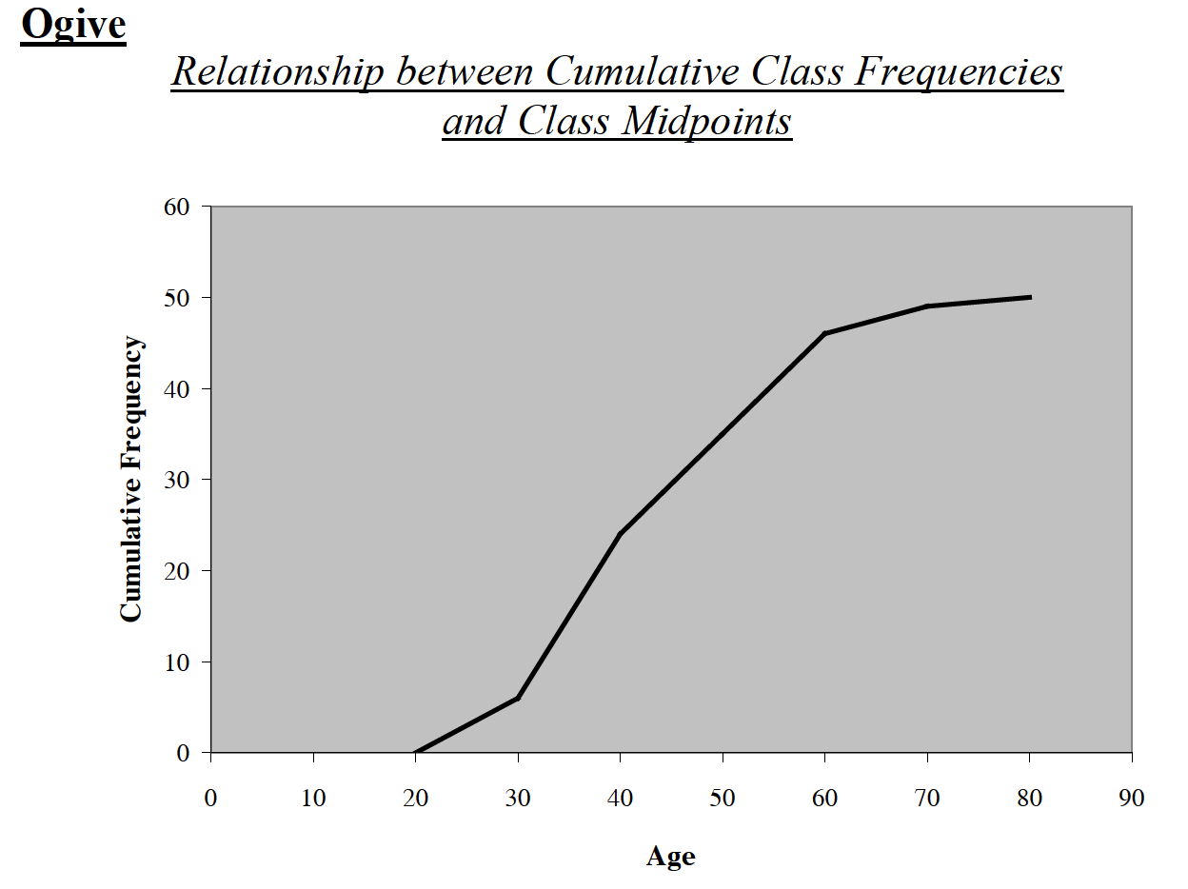
COMMON STATISTICAL GRAPHS

Slide 31
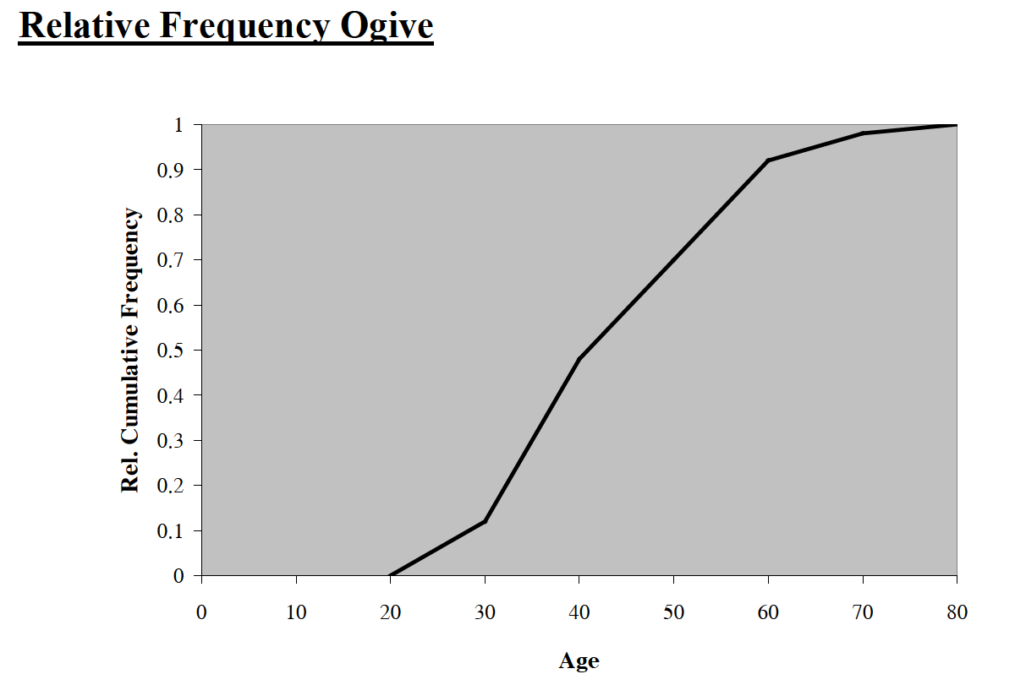
COMMON STATISTICAL GRAPHS

Slide 32
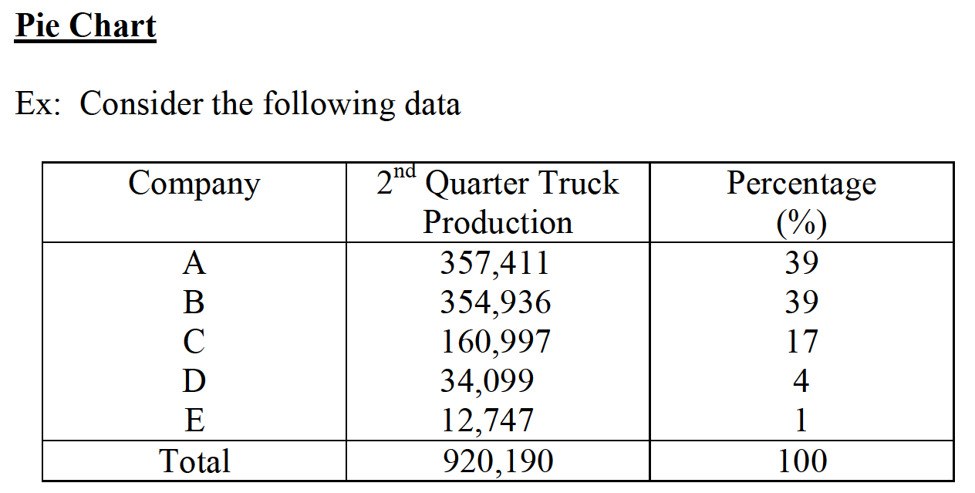
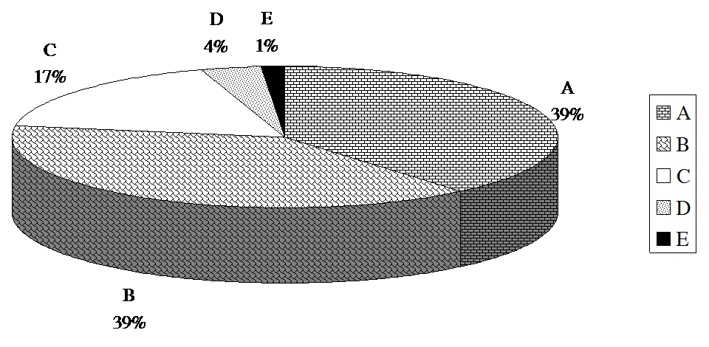
COMMON STATISTICAL GRAPHS

Slide 33
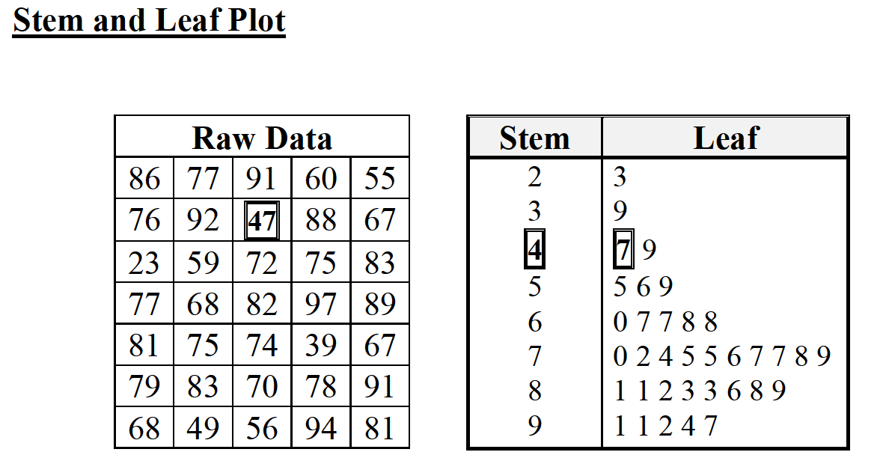
COMMON STATISTICAL GRAPHS

Slide 34
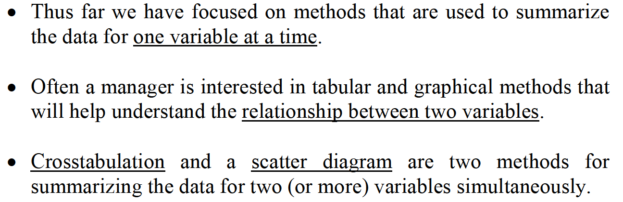
CROSSTABULATION & SCATTER DIAGRAM

Slide 35
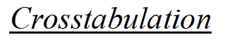
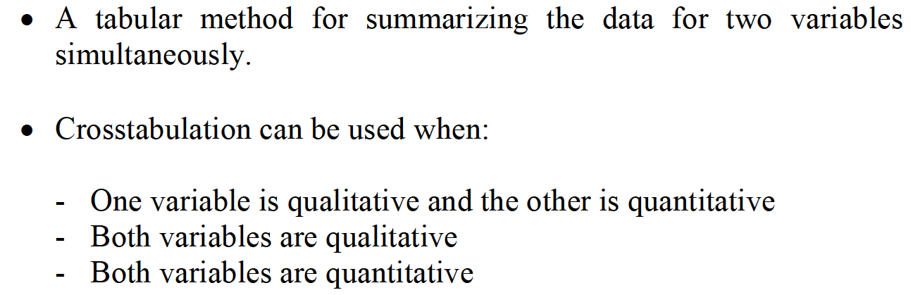
CROSSTABULATION & SCATTER DIAGRAM

Slide 36
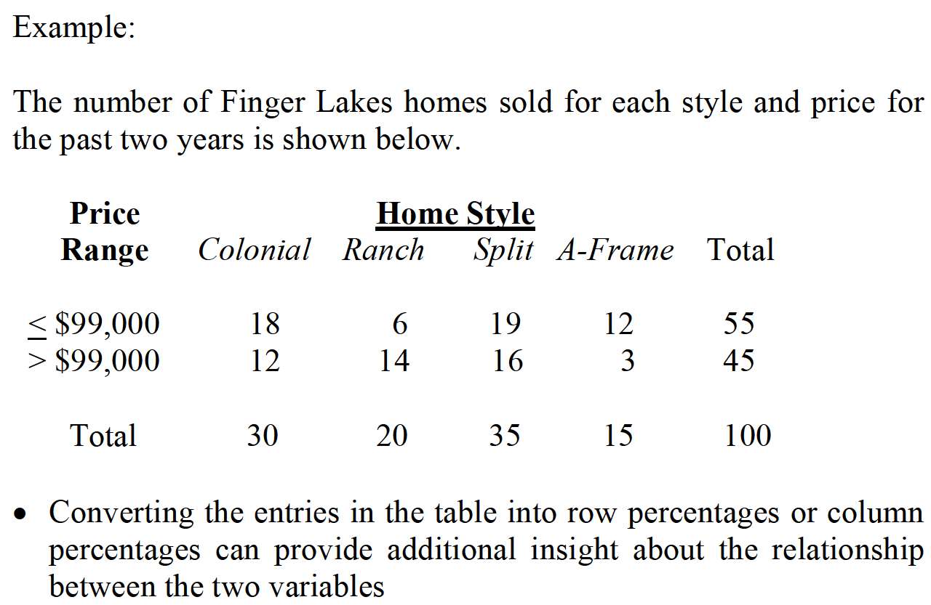
CROSSTABULATION & SCATTER DIAGRAM

Slide 37
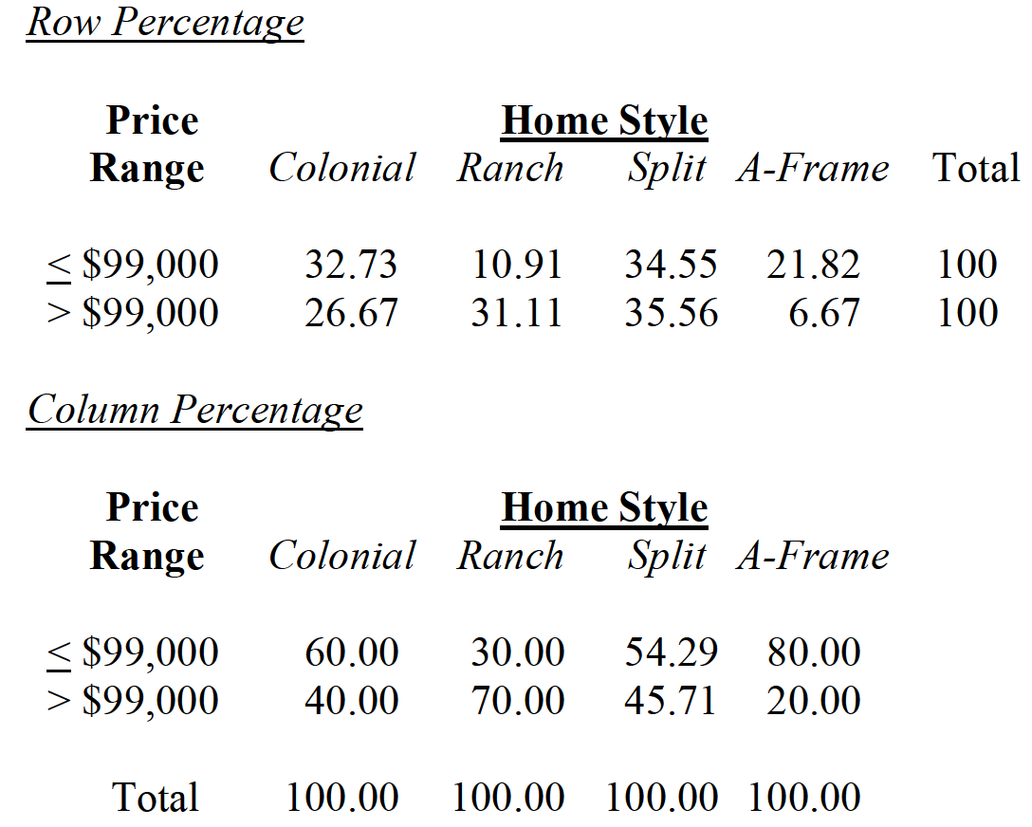
CROSSTABULATION & SCATTER DIAGRAM

Slide 38
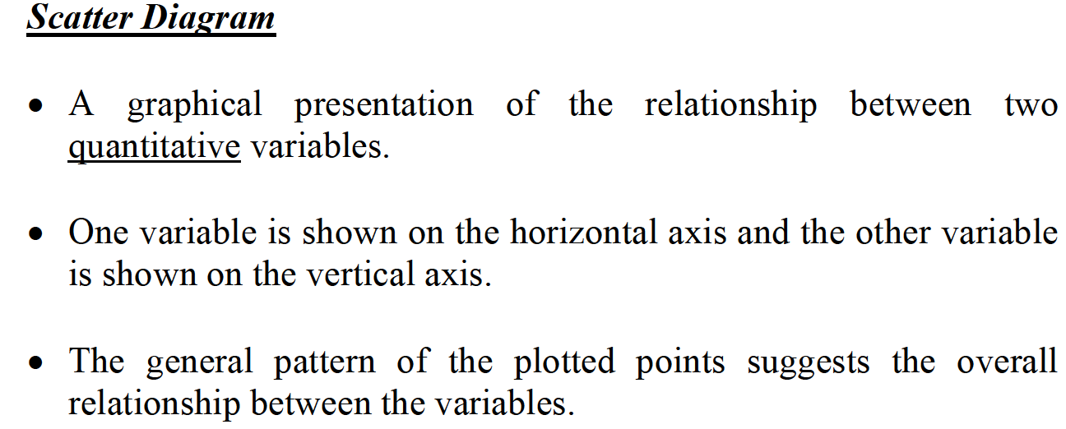



CROSSTABULATION & SCATTER DIAGRAM

Slide 39


DESCRIPTIVE STATISTICS

Slide 40

DESCRIPTIVE STATISTICS

Slide 41

MEASURES OF CENTRAL TENDENCY – UNGROUPED DATA

Slide 42


MEASURES OF CENTRAL TENDENCY – UNGROUPED DATA

Slide 43


MEASURES OF CENTRAL TENDENCY – UNGROUPED DATA

Slide 44

MEASURES OF CENTRAL TENDENCY – UNGROUPED DATA

Slide 45




MEASURES OF CENTRAL TENDENCY – UNGROUPED DATA

Slide 46


MEASURES OF CENTRAL TENDENCY – UNGROUPED DATA

Slide 47

MEASURES OF CENTRAL TENDENCY – UNGROUPED DATA

Slide 48

MEASURES OF CENTRAL TENDENCY – UNGROUPED DATA

Slide 49



MEASURES OF CENTRAL TENDENCY – UNGROUPED DATA

Slide 50

MEASURES OF CENTRAL TENDENCY – UNGROUPED DATA

Slide 51



MEASURES OF VARIABILITY – UNGROUPED DATA

Slide 52

MEASURES OF VARIABILITY – UNGROUPED DATA

Slide 53

MEASURES OF VARIABILITY – UNGROUPED DATA

Slide 54

MEASURES OF VARIABILITY – UNGROUPED DATA

Slide 55



MEASURES OF VARIABILITY – UNGROUPED DATA

Slide 56

MEASURES OF VARIABILITY – UNGROUPED DATA

Slide 57



MEASURES OF VARIABILITY – UNGROUPED DATA

Slide 58

MEASURES OF VARIABILITY – UNGROUPED DATA

Slide 59


MEASURES OF VARIABILITY – UNGROUPED DATA

Slide 60



MEASURES OF VARIABILITY – UNGROUPED DATA

Slide 61

MEASURES OF VARIABILITY – UNGROUPED DATA

Slide 62

MEASURES OF CENTRAL TENDENCY – GROUPED DATA

Slide 63


MEASURES OF CENTRAL TENDENCY – GROUPED DATA

Slide 64


MEASURES OF CENTRAL TENDENCY – GROUPED DATA

Slide 65


MEASURES OF CENTRAL TENDENCY – GROUPED DATA

Slide 66



MEASURES OF CENTRAL TENDENCY – GROUPED DATA

Slide 67


MEASURES OF CENTRAL TENDENCY – GROUPED DATA

Slide 68

MEASURES OF CENTRAL TENDENCY – GROUPED DATA

Slide 69

MEASURES OF CENTRAL TENDENCY – GROUPED DATA

Slide 70

MEASURES OF SHAPE

Slide 71



MEASURES OF SHAPE

Slide 72



MEASURES OF SHAPE

Slide 73




MEASURES OF SHAPE

Slide 74

DETERMINATION OF OUTLIERS

Slide 75


DETERMINATION OF OUTLIERS

Slide 76


DETERMINATION OF OUTLIERS

Slide 77

SAMPLING AND SAMPLING DISTRIBUTIONS

Slide 78

SAMPLING AND SAMPLING DISTRIBUTIONS

Slide 79


SAMPLING AND SAMPLING DISTRIBUTIONS

Slide 80


SAMPLING AND SAMPLING DISTRIBUTIONS

Slide 81

SAMPLING AND SAMPLING DISTRIBUTIONS

Slide 82


SAMPLING AND SAMPLING DISTRIBUTIONS

Slide 83


SAMPLING AND SAMPLING DISTRIBUTIONS

Slide 84

SAMPLING AND SAMPLING DISTRIBUTIONS

Slide 85


SAMPLING AND SAMPLING DISTRIBUTIONS

Slide 86

SAMPLING AND SAMPLING DISTRIBUTIONS

Slide 87




SAMPLING AND SAMPLING DISTRIBUTIONS

Slide 88

SAMPLING AND SAMPLING DISTRIBUTIONS

Slide 89


SAMPLING AND SAMPLING DISTRIBUTIONS

Slide 90

SAMPLING AND SAMPLING DISTRIBUTIONS

Slide 91


SAMPLING AND SAMPLING DISTRIBUTIONS

Slide 92

SAMPLING AND SAMPLING DISTRIBUTIONS

Slide 93


SAMPLING AND SAMPLING DISTRIBUTIONS

Slide 94

SAMPLING AND SAMPLING DISTRIBUTIONS

Slide 95

SAMPLING AND SAMPLING DISTRIBUTIONS

Slide 96

SAMPLING AND SAMPLING DISTRIBUTIONS

Slide 97


SAMPLING AND SAMPLING DISTRIBUTIONS

Slide 98

SAMPLING AND SAMPLING DISTRIBUTIONS

Slide 99

SAMPLING AND SAMPLING DISTRIBUTIONS

Slide 100

SAMPLING AND SAMPLING DISTRIBUTIONS

Slide 101


SAMPLING AND SAMPLING DISTRIBUTIONS

Slide 102

SAMPLING AND SAMPLING DISTRIBUTIONS

Slide 103

SAMPLING AND SAMPLING DISTRIBUTIONS

Slide 104

SAMPLING AND SAMPLING DISTRIBUTIONS

